Slide 1
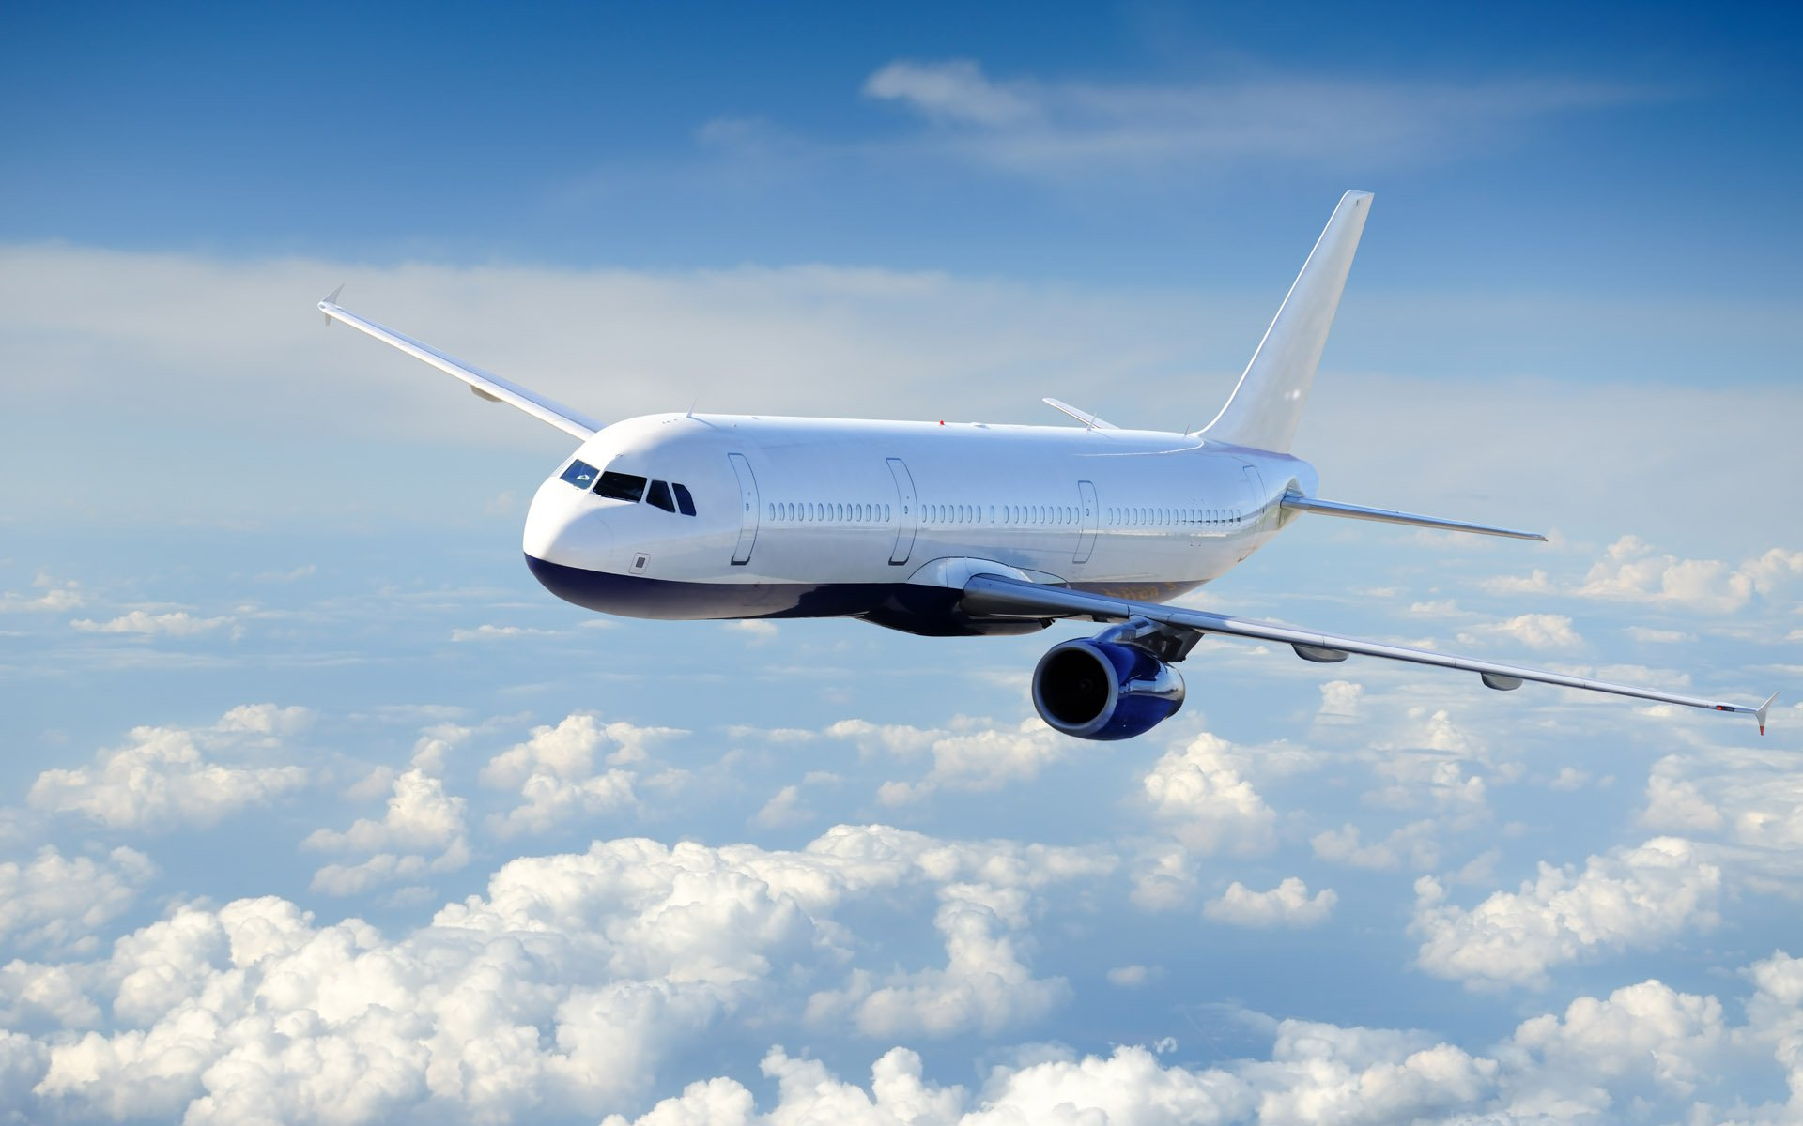
Predicting Flight Delays
Calvin Chua
DAT 9

Slide 2
Predicting Flight Delays
Problem
Onion Travel Agency (OTA) is a new player to the US market and wants to carve a name for themselves by ensuring customers encounter minimal delays. As such, OTA needs to be able to predict flight delays to make the most convenient bookings for their customers. As the end-of-year holiday season is key, OTA’s focus is on the months of November and December.
Project Goal
To predict flight delays through analysis of the various factors causing delays in previous years.
Hypothesis/Assumption
Assumption: Time/day of flight departure/arrival, airport of departure/arrival contribute to delays. (Fields are chosen based on this assumption)
Null Hypothesis 1: Airports are not a contributing factor in delays
Alternate Hypothesis 1: Airports are a contributing factor to delays
Null Hypothesis 2: Flight arrival/departure day and time are not contributing factors to delays
Alternate Hypothesis 2: Flight arrival/departure day and time are contributing factors to delays
Limitations
Data is only true for US airports and domestic flights
Analysis is only true for a specific period (i.e. November/December)
Notes:
Draft a well-formed problem statement relevant to a business problem affecting your team, division, or organization.
Include the following elements: Hypothesis/assumptions
Goals and success metrics
Risks or limitations

Slide 3
Identified Dataset
Sample Data (Nov 2017):
Publicly available data is taken from the “Bureau of Transportation Statistics” website.
(https://www.transtats.bts.gov/Tables.asp?DB_ID=120)
Data Timeframe:
November/December
Years 2012-2017
Data Shape (Sample):
Rows: 454163
Columns: 31
Features
Travel Period: Month, Day, Time
Airline: Carrier Code, Flight Number, Tail Number
Airport: Origin Airport and City, Destination Airport and City
Departure/Arrival Performance: CRS Time, Actual time
Cancellations: Cancelled, Cancellation Code, Diverted
Cause of Delay: Carrier Delay, Weather Delay, NAS Delay, Security Delay, Late Aircraft Delay
Terms:
CRSDepTime (the local time the plane was scheduled to depart)
CRSArrTime (the local time the plane was scheduled to arrive)
CRSElapsedTime (the scheduled difference between departure and arrival)
NAS Delay: National Air System Delay
Definitions in delay types can be found at: http://aspmhelp.faa.gov/index.php/Types_of_Delay)
Notes:
Include the following elements: Hypothesis/assumptions
Goals and success metrics
Risks or limitations

Slide 4
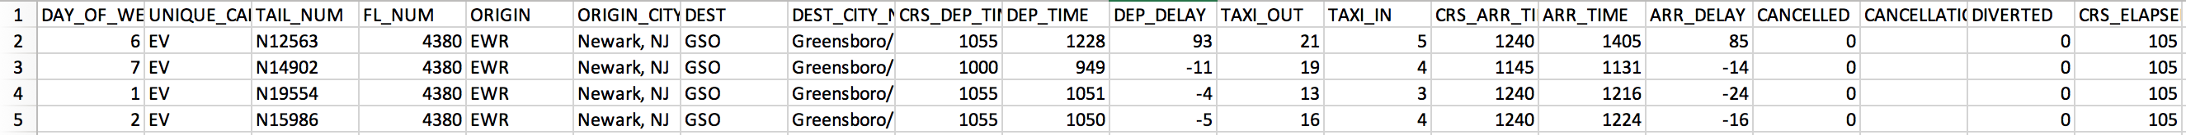
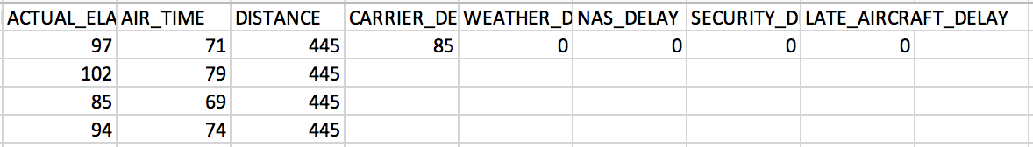
Sample Data
Are delays more common on particular days?
Are delays more common from or to particular cities?
Are delays more common on particular flights or planes?
Are delays more common on particular arrival or departure times?
Are delays due to weather or other causes?

Slide 5
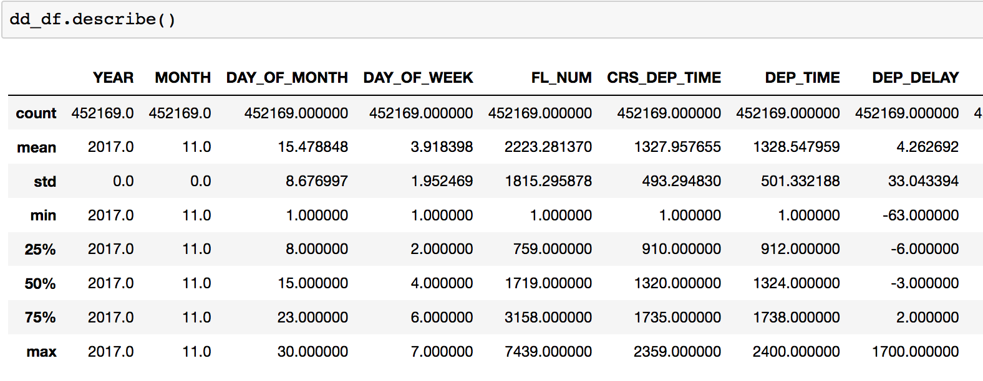
EDA
Drop features that are not needed.
'ORIGIN_CITY_NAME’ and 'DEST_CITY_NAME’ were removed
Remove rows without important information
99.5% of data remaining
Brief description of numerical features
Average of 4.3 mins for dep. delay

Slide 6
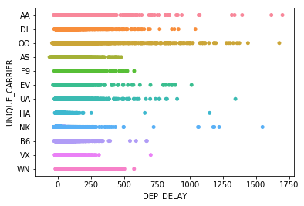
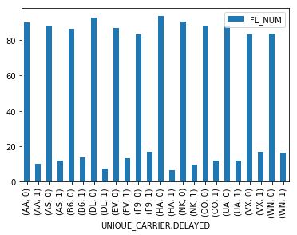
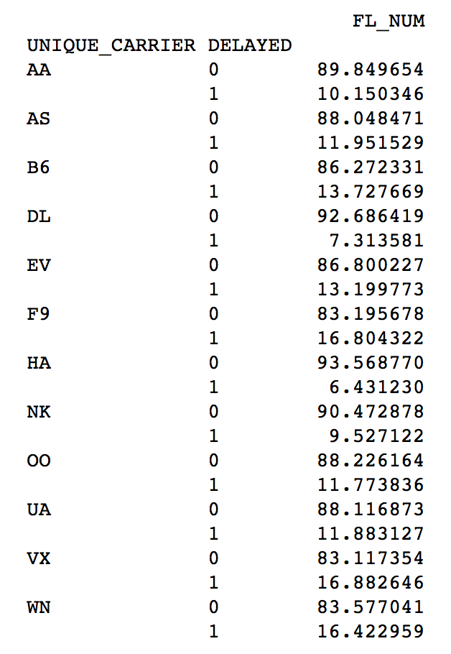
EDA
Which airlines are more prone to delays?
Scatter plot of airline vs delay times
Carrier Code | Carrier | % Delay
VX | Virgin America | 16.9%
F9 | Frontier Airlines | 16.8%
WN | Southwest Airlines Co. | 16.4%
B6 | JetBlue Airways | 13.7%
EV | Atlantic Southeast Airlines | 13.2%
AS | Alaska Airlines Inc. | 11.9%
UA | United Air Lines Inc. | 11.9%
OO | Skywest Airlines Inc. | 11.8%
AA | American Airlines Inc. | 10.1%
NK | Spirit Air Lines | 9.5%
DL | Delta Air Lines Inc. | 7.3%
HA | Hawaiian Airlines Inc. | 6.4%
FAA considers a flight to be delayed when it is 15 minutes later than its scheduled time
A negative time means that the flight is ahead of schedule
Notes:
While VX, F9 and WN have the highest percentage delay, AA,/OO/NK have the longest delays.

Slide 7
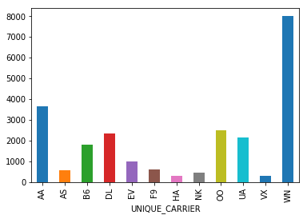
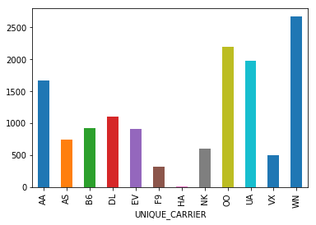
EDA
What kinds of delays are more frequent?
Carrier Code | Carrier | Carrier | Weather | NAS | Security | Late Aircraft | Total
AA | American Airlines Inc. | 3,633 | 104 | 1,663 | 57 | 2,611 | 8,068
AS | Alaska Airlines Inc. | 574 | 115 | 745 | 17 | 628 | 2,079
B6 | JetBlue Airways | 1,792 | 11 | 921 | 30 | 1,398 | 4,152
DL | Delta Air Lines Inc. | 2,328 | 147 | 1,097 | 9 | 1,303 | 4,884
EV | Atlantic Southeast Airlines | 984 | 31 | 910 | 0 | 1,191 | 3,116
F9 | Frontier Airlines | 579 | 9 | 315 | 0 | 619 | 1,522
HA | Hawaiian Airlines Inc. | 293 | 8 | 2 | 1 | 230 | 534
NK | Spirit Air Lines | 458 | 10 | 595 | 17 | 313 | 1,393
OO | Skywest Airlines Inc. | 2,484 | 300 | 2,193 | 16 | 3,857 | 8,850
UA | United Air Lines Inc. | 2,140 | 55 | 1,973 | 0 | 2,140 | 6,308
VX | Virgin America | 298 | 21 | 496 | 15 | 427 | 1,257
WN | Southwest Airlines Co. | 7,979 | 134 | 2,667 | 80 | 8,206 | 19,066
 |  | 23,542 | 945 | 13,577 | 242 | 22,923
No. of carrier delay by airline
No. of NAS delay by airline

Slide 8
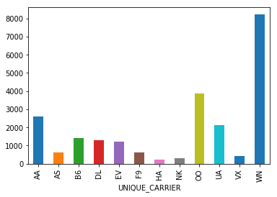
EDA
What kinds of delays are more frequent?
No. of carrier delay by airline
No. of late aircraft delay by airline
No. of NAS delay by airline

Slide 9
EDA
Which airports are more prone to delays?

Slide 10
Moving Forward
To Complete EDA:
Merge all data
Examine any missing values
Visualization
Airport
Time (hour)

